Slide 1
Behavioural & Experimental Economics Decision-making under Risk & Uncertainty
Adrien Fillon
University of Cyprus

Slide 2
Course Outline
Choice under Certainty
Judgement under Risk & Uncertainty
Choices under Risk & Uncertainty
Intertemporal Choice
Strategic Interaction

Slide 3
Course Outline
Choice under Certainty
Judgement under Risk & Uncertainty
Choices under Risk & Uncertainty
Rational Choice under Risk & Uncertainty
Decision-making under Risk & Uncertainty
Intertemporal Choice
Strategic Interaction

Slide 4
Risk vs. Uncertainty
In choice under certainty, risk and uncertainty are not an issue.
A choice under uncertainty is made when the probabilities of the relevant outcomes are unknown or not meaningful.
A choice under risk is made when the probabilities of the outcomes are meaningful and known.

Slide 5
Utility maximization
In terms of utility, Rational choice implies:
To have a rational preference ordering
=> To have a utility function
Faced with a menu of choices / a budget, the person chooses the most preffered item, or (in case of ties) one of the most preferred items.
=> To maximize utility

Slide 6
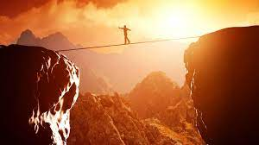
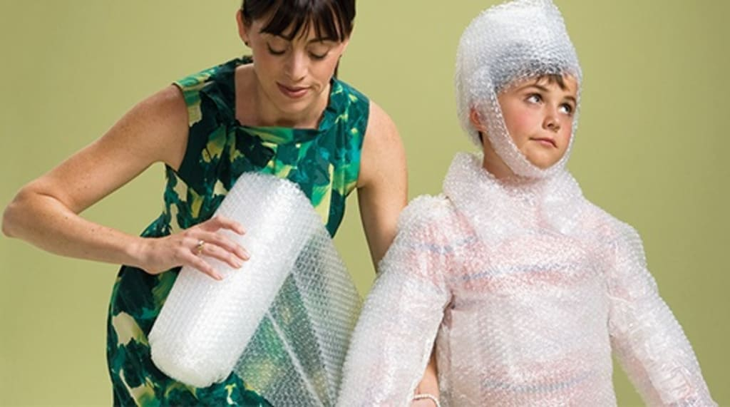
Risk prone and risk aversion

Slide 7
Remember this problem?
There is an impending pandemic threatening to kill 600 people and you have two options: (A) Save 200 people (B) Save 600 people with 1/3 chance and save 0 people with 2/3 chance.
The same disease is threatening society, but you are given two different options this time: (C) Kill 400 people (D) Kill 0 people with 1/3 chance and kill 600 people with 2/3 chance.
An expected-utility maximizer should make the same choice in both cases

Slide 8
Expected utility (risk averse)
u(x)
u(600)
u(200)
u(0)
0
200
600
lives

Slide 9
Expected utility (risk prone)
u(x)
u(600)
u(200)
u(0)
0
200
600
lives

Slide 10
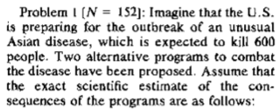
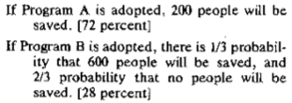
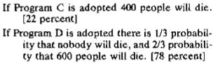
Loss aversion
People tend to dislike losses more than they like gains.
72%
28%
Risk averse
22%
78%
Risk prone

Slide 11
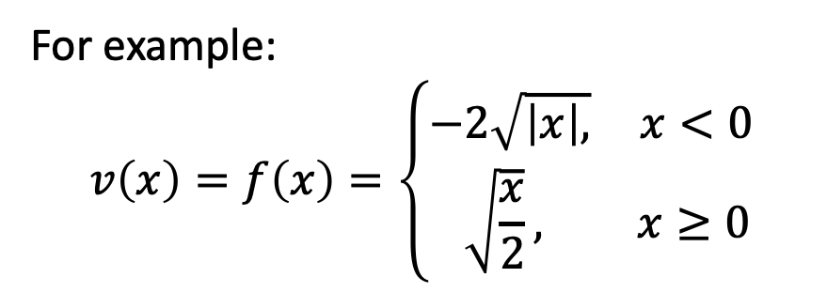
The value function under risk & uncertainty
v(x)
For example:
$$v\left(x\right)=f\left(x\right)=\left\{\begin{aligned}−&2\sqrt{\left|x\right|,} x<0 \\ &\sqrt{\frac{x}{2}}, x≥0\end{aligned}\right.$$
losses
gains
x
This implies that people are:
Risk averse for gains
Risk prone for losses

Slide 12
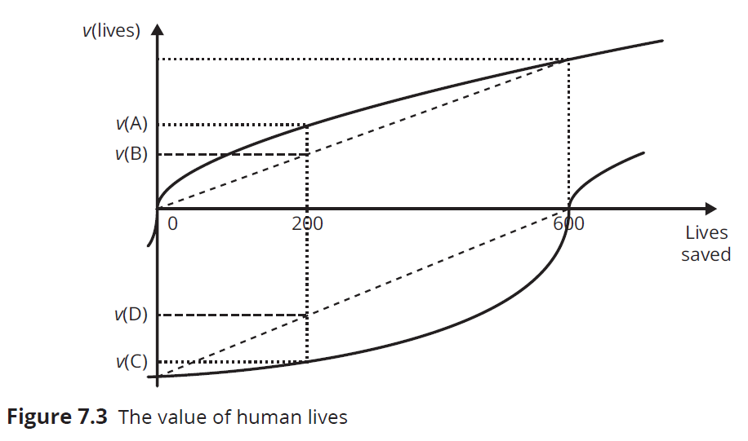
Two Different Results?
Framing creates two different value functions.

Slide 13
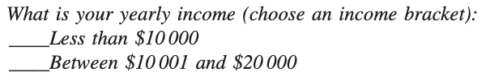
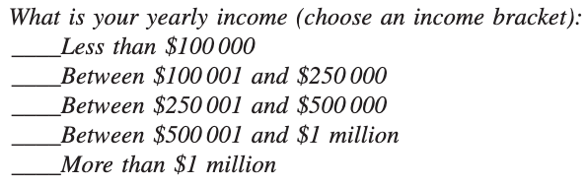
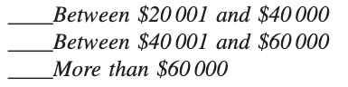
Haisley et al. 2008
Manipulating choices by manipulating perceptions of relative income.
Then they gave them $ dollars and also offered them to buy $1-lottery-tickets.
Notes:
Framing « you are rich » and « you are poor »

Slide 14
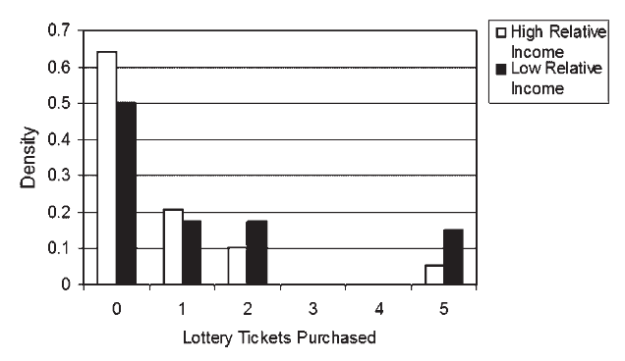
Haisley et al. 2008

Slide 15
Bundling & mental accounting

Slide 16
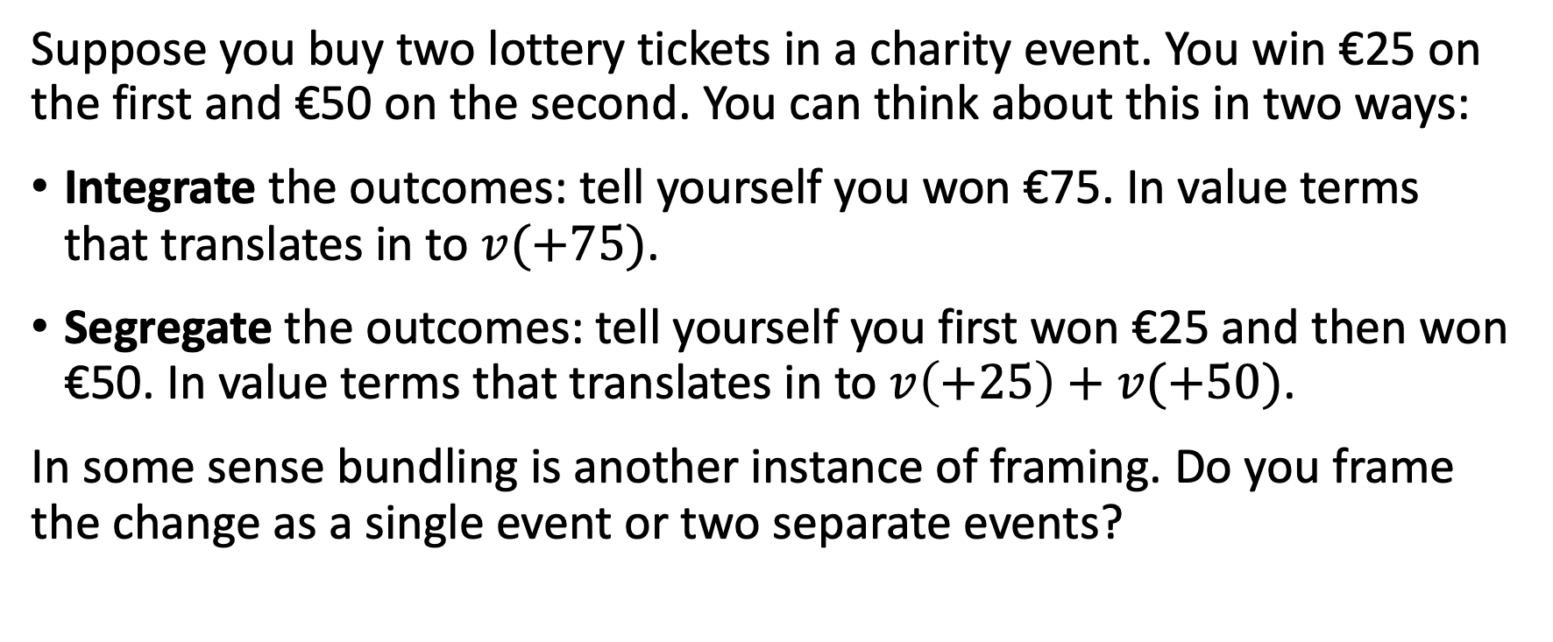
Example
Suppose you buy two lottery tickets in a charity event. You win €25 on the first and €50 on the second. You can think about this in two ways:
Integrate the outcomes: tell yourself you won €75. In value terms that translates in to $v(+75)$.
Segregate the outcomes: tell yourself you first won €25 and then won €50. In value terms that translates in to $v\left(+25\right)+v(+50)$.
In some sense bundling is another instance of framing. Do you frame the change as a single event or two separate events?

Slide 17
v(x)
v(x)
v(+75)
v(+25)
+25
+50
+75
x
+25
+50
x
Integration
Segregation

Slide 18
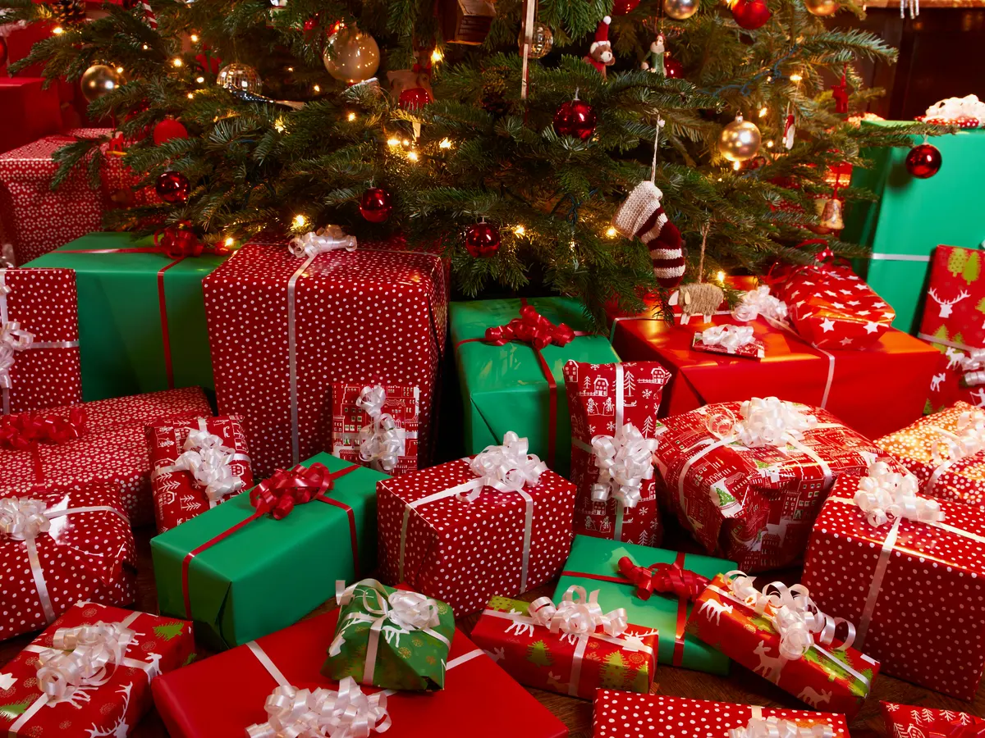
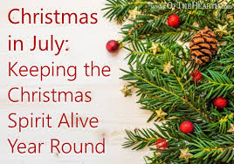
Notes:
The fact that gains are valued more when segregated helps explain a variety of
phenomena. For example, it explains why people do not put all their Christmas
presents in one big box, even though that would save them time and money on
wrapping: the practice of wrapping each present separately encourages the recipient
to segregate the gains,
it is better to give people multiple
small presents over the course of the year than to give them one big present once a
year.

Slide 19
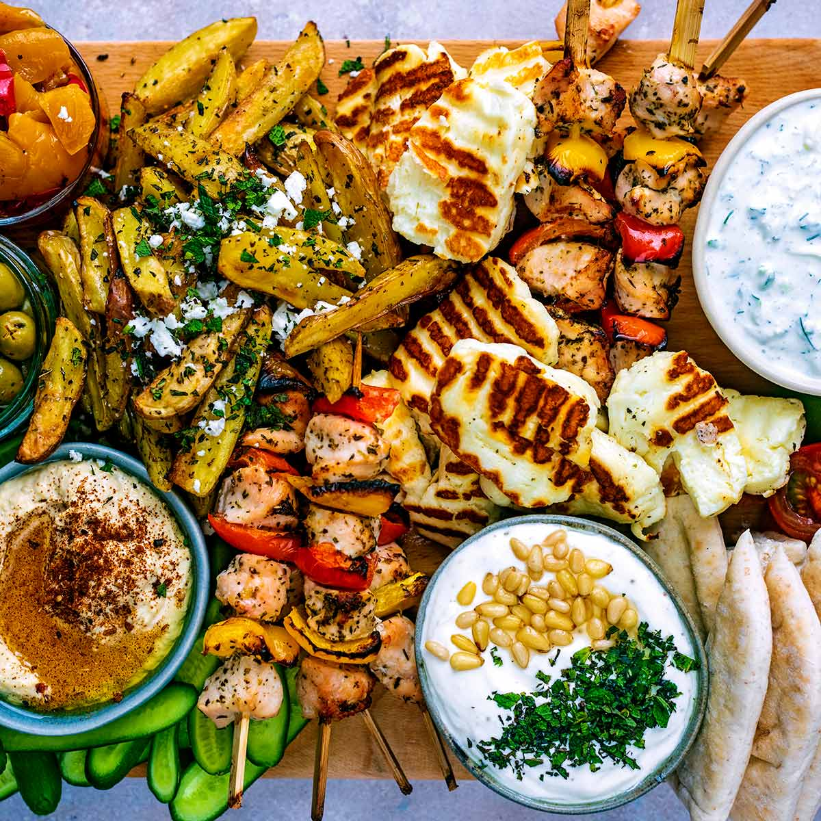

Notes:
Similarly, segregation explains why fancy meals are served up dish-bydish,
rather than all at one time: chances are the eater will enjoy it more that way

Slide 20
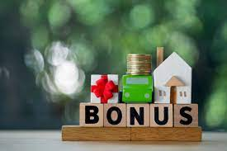
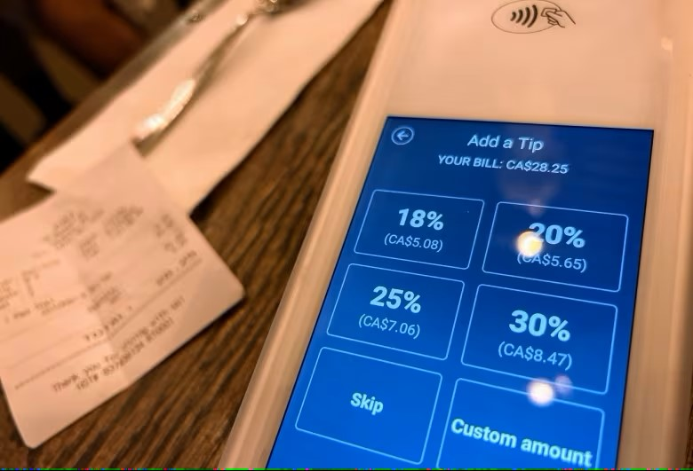
Notes:
receiving a $50k salary plus a $5k bonus encourages the segregation of
gains in a manner that receiving a $55k salary does not,
You already payed a lot for the restaurant, is a bit more for tips a lot?

Slide 21
Bundling
More generally, prospect theory predicts:
Gains are more valued when segregated
Many small gifts instead of one large one.
Losses are hurt less when integrated
“The death of a man is a tragedy, the death of millions is a statistic”
Allows us to understand:
Expensive add-ons are offered when buying pricey goods (cars, homes,etc.)
The use of credit cards.
Preference to own a car even if not used much and taking taxis is cheaper.

Slide 22
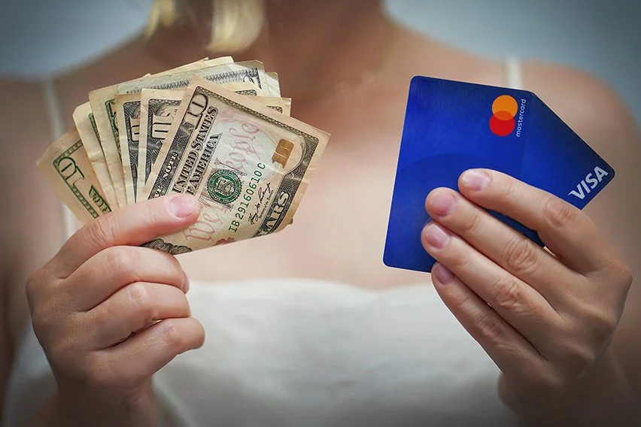
Advice
Notes:
When you use a credit card, though the monthly bill might be alarming, it only arrives once
a month, thereby encouraging you to integrate the losses,
By contrast, the satisfaction of receiving the things you buy is distributed throughout the month, thereby
encouraging the segregation of gains.

Slide 23
Thought experience
You pay
You get the product
You pay
You get the product
You pay
You pay
You get all products in a box at the end of the month
You pay
You pay
You pay
You pay
Notes:
(a) Would you make more or fewer purchases this way?
(b) Use the language of integration and segregation to explain why.
(a) Chances are you would make fewer purchases. (b) The arrangement would
encourage you to segregate your losses but integrate your gains, which would simultaneously
increase the pain of paying for your stuff and reduce the enjoyment you would derive from it.

Slide 25
Sure-thing principle and the Allais problem

Slide 26
The Allais problem
Pick one of the following:
(1a) $1 million for sure
(1b) 89% chance of $1 million and a 10% chance of $5 million
Pick one of the following:
(2a) 11% chance of $1 million
(2b) 10% chance of $5 million

Slide 27
The Allais problem, cont.
Many people choose (1a) and (2b).
Yet, (1a) entails that u(1M)>0.89*u(1M)+0.10*u(5M).
And (2b) entails that 0.10*u(5M)>0.11*u(1M).
That’s a contradiction.

Slide 28
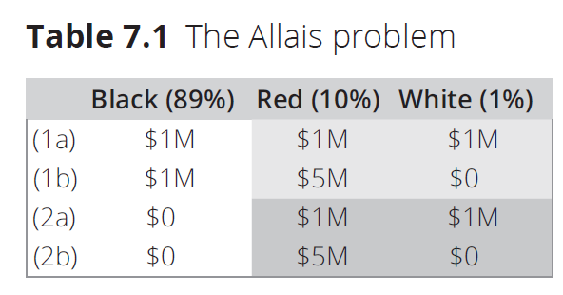
The Sure-Thing Principle
The common choices for the Allais problem violate the sure-thing principle, which stipulates that one’s decisions should not be influenced by sure things.

Slide 29
How do we Explain This?
The violation may be explained by a certainty effect, which says that individuals overweight outcomes that are certain.
This can coincide with regret aversion because individuals know they might regret the risky choice over the sure thing.

Slide 30
Certainty effect in the real world
In a study of 72 physicians attending a meeting of the California Medical Association, physicians were asked which treatment they would favor for a patient with a tumor, given the choice between a radical treatment such as extensive surgery, which involves a greater chance of imminent death, and a moderate treatment such as radiation:
80% chance of long life & 20% chance of imminent death.
100% chance of short life & 0% chance of imminent death.
20% chance of long life & 80% chance of imminent death.
25% chance of short life & 75% chance of imminent death.

Slide 31
Certainty effect in the real world
In a study of 72 physicians attending a meeting of the California Medical Association, physicians were asked which treatment they would favorfor a patient with a tumor, given the choice between a radical treatment such as extensive surgery, which involves a greater chance of imminent death, and a moderate treatment such as radiation:
80% chance of long life & 20% chance of imminent death.
100% chance of short life & 0% chance of imminent death.
20% chance of long life & 80% chance of imminent death.
25% chance of short life & 75% chance of imminent death.
35%
68%
32%
65%

Slide 32
Ambiguity Aversion and the Ellsberg problem

Slide 33
The Ellsberg Problem
You are picking a ball from an urn with 90 balls in it. 30 are red and the remaining 60 are a mix of black and yellow (ranging from all black to all yellow). You are given the following 2 bets:
Bet 1:
$100 if the ball is red
$100 if the ball is black
Bet 2:
$100 if the ball is red or yellow
$100 if the ball is black or yellow

Slide 34
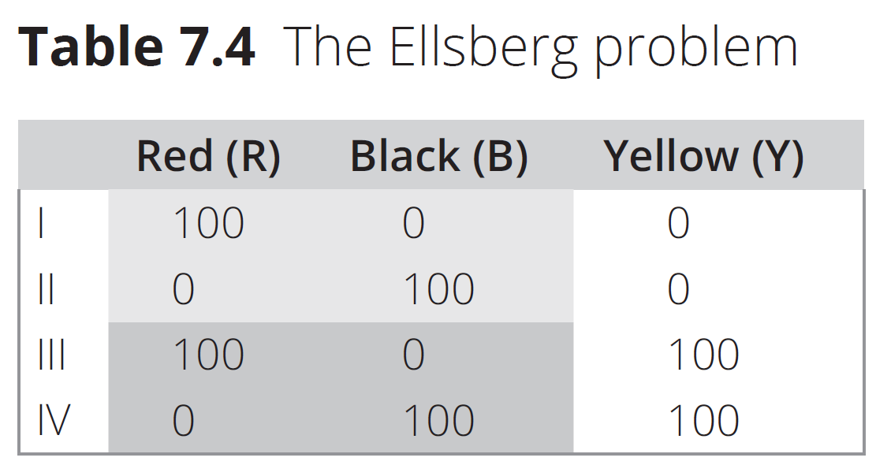
Did You Violate the Sure-Thing Principle?

Slide 35
How to Explain Violations
The choices involving the black and yellow balls were ambiguous.
Many individuals are unwilling to take on gambles with ambiguous probabilities.
This tendency is called ambiguity aversion.
Ambiguity aversion is irrational according to expected-utility theory. But is it??

Slide 36
Probability Weighting and Prospect Theory

Slide 37
A paradox?
A value function that is concave for gains and convex for losses explains many types of behavior.
Still, some common patterns seem to contradict this idea.
For instance we observe people that gamble but also buy insurance!
A possible explanation:
Overweighting of unlikely events

Slide 38
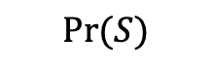
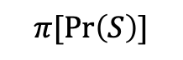


Probability weighting
$$π[\operatorname{Pr}\left(S\right)]$$
$$π(1)$$
$$π(0)$$
0
1
$$Pr⁡(S)$$

Slide 39
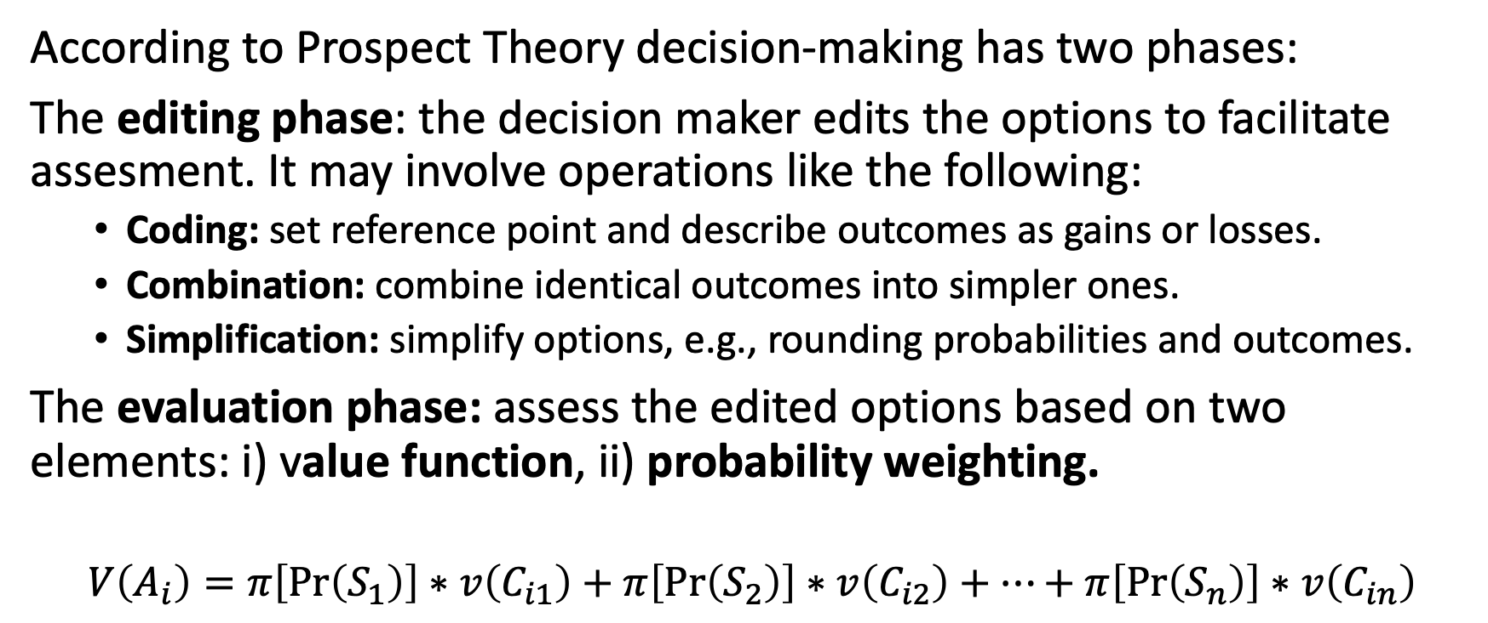
Prospect Theory
According to Prospect Theory decision-making has two phases:
The editing phase: the decision maker edits the options to facilitate assesment. It may involve operations like the following:
Coding: set reference point and describe outcomes as gains or losses.
Combination: combine identical outcomes into simpler ones.
Simplification: simplify options, e.g., rounding probabilities and outcomes.
The evaluation phase: assess the edited options based on two elements: i) value function, ii) probability weighting.
$$V\left(A_{i}\right)=π\left[\operatorname{Pr}\left(S_{1}\right)\right]∗v\left(C_{i1}\right)+π\left[\operatorname{Pr}\left(S_{2}\right)\right]∗v\left(C_{i2}\right)+…+π\left[\operatorname{Pr}\left(S_{n}\right)\right]∗v\left(C_{in}\right)$$

